Slide 1
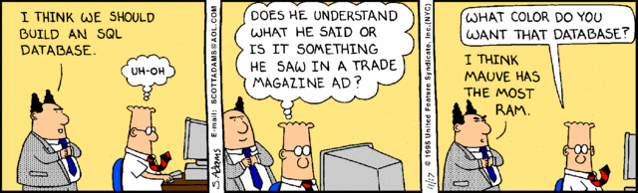

Slide 2
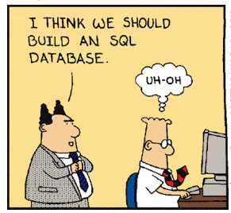

Slide 3
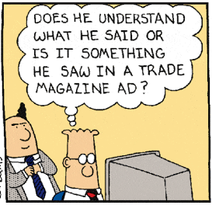

Slide 4
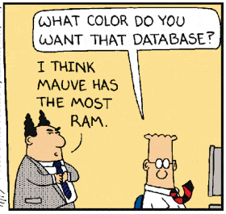

Slide 5
Databases

Slide 6
Administrivia
Course info:
Webpage will be the main source of knowledge.
Contact me through email or Slack (Slack is better for real-time discussion.)
Pre-req: CS241
Coursework:
Homework, group project, midterm, final
Sign up for the CS Slack channel.
Be prepared to bring laptops every so often.

Slide 7
Standard stuff
Class webpage: https://pkirlin.github.io/db-s24/
Textbook: get it somewhere; used is fine
Stay up with reading!
Be prepared to bring laptops every so often.

Slide 8
Group project
You will design and implement your own database-driven website.
Ideas: shopping, auctions, write a better BannerWeb, library/bibliography system, reviews (Yelp), bank, finance/stocks, job postings, social networking (Instagram, Twitter), recipes, movies, apartments (AirBnB), …
Groups: probably 4-5 people, formed on your own.
Spread out over the whole semester; check-ins along the way.

Slide 9
Office Hours
Please come! These are a resource for you. Typically they are underutilized.
Also send me email or a Slack message for "unscheduled" office hours.
I can't promise I'll respond immediately, but I'll always get back to you within a day, and we can most likely schedule a time to meet.

Slide 10
How to succeed
Come to class.
Ask questions when you are confused: in class or office hours.
Take notes, preferably on paper.
Do not leave readings, homework, projects to the last minute. You can't BS (most) of these.
Notes:
The more I see folks in office hours, the better I can make the course b/c I know what ppl are confused by.

Slide 11
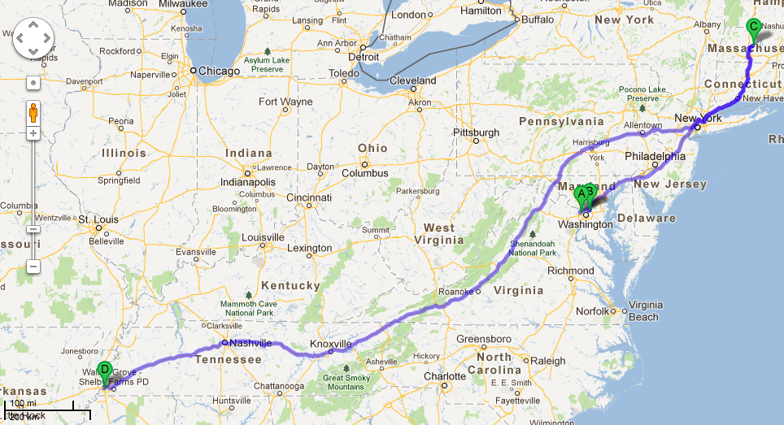
A little about me

Slide 12
A little about you
Name
Year at Rhodes (first-year, sophomore, etc.)
Where you're from
What is your favorite midnight snack?
Bonus points if you introduce us to your pet(s) as well.

Slide 13
Why study databases?
Academic reasons
Programming reasons
Business (get a job) reasons
Student reasons
Notes:
SEE NOTES

Slide 14
What will you learn?
Database design
How do you model your data so it can be stored in a database?
Database programming
How do I use a database to ask it questions about my data (queries)?
How do I use a programming language to interact with a database?
Database implementation
How does the database itself work; i.e., how does it store, find, and retrieve data efficiently?

Slide 15
What is the goal of a database?
Electronic record-keeping, enabling fast and convenient access to the information inside.
DBMS = Database management system
Software that stores individual databases and knows how to search the information inside.
RDBMS = Relational DBMS
Examples: Oracle, MS SQL Server, MS Access, MySQL, PostgreSQL, IBM DB2, SQLite
Notes:
https://db-engines.com/en/ranking

Slide 16
DBMS Features
Support massive amounts of data
Giga-, tera-, petabytes
Persistent storage
Data continues to live long after program finishes.
Efficient and convenient access
Efficient: don't search the entire thing to answer a question!
Convenient: allow users to ask questions as easily as possible.
Secure, concurrent, and atomic access

Slide 17
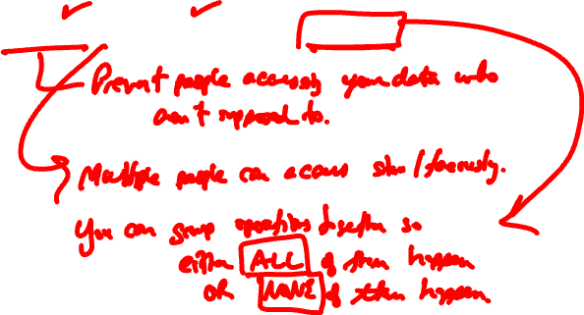
Secure, concurrent, and atomic access

Slide 18
Example: build a better Workday
Professors offer classes, students register, get grades
What are some questions we (students or faculty) could ask of this database system?
Find my GPA.
…

Slide 19
Example: build a better Workday
Why are security, concurrency, and atomicity important here?

Slide 20

Solution 1
Advantages?
Disadvantages?

Slide 21
Solution 2
Text files and Python/Java programs

Slide 22

Solution 3
Let's use CSV: (comma-separated values)
Hermione,Granger,R123,Potions,A
Draco,Malfoy,R111,Potions,B
Harry,Potter,R234,Potions,A
Ronald,Weasley,R345,Potions,C

Slide 23
What's the issue here?
Hermione,Granger,R123,Potions,A
Draco,Malfoy,R111,Potions,B
Harry,Potter,R234,Potions,A
Ronald,Weasley,R345,Potions,C
Harry,Potter,R234,Herbology,B
Hermione,Granger,R123,Herbology,A

Slide 24
File 1:
Hermione,Granger,R12
Draco,Malfoy,R111
Harry,Potter,R234
Ronald,Weasley,R345
File 2:
R123,Potions,A
R111,Potions,B
R234,Potions,A
R345,Potions,C
R234,Herbology,B
R123,Herbology,A

Slide 25
Problems
Inconvenient – need to know Python/Java to get at data!
Redundancy/inconsistency
Integrity problems
Atomicity problems
Concurrent access problems
Security problems

Slide 26
Why are there problems?
Two main reasons:
The description of how the files are laid out is buried within the Python/Java code itself (if it's documented at all)
There is no support for transactions (supporting concurrency, atomicity, integrity, and recovery)
DBMSs handle exactly these two problems.

Slide 27
Relational database systems
Edgar F. Codd was a researcher at IBM who conceived a new way of organizing data based on the mathematical concept of a relation. (1970)
Relation: a set of ordered tuples (oh, no, CS172 stuff…)

Slide 28
Highlights of RDBMS
(R)DBMS = relational database management system.
Data is stored in relations, which resemble tables:
Underlying data structures are more complicated.
First | Last | Course | Grade
Hermione | Granger | Potions | A
Draco | Malfoy | Potions | B
Harry | Potter | Potions | A
Ronald | Weasley | Potions | C

Slide 29
Highlights of RDBMS
Users issue queries to the DBMS, which are handled by the query processor.
Behind the scenes: query optimizer handles all the details of figuring out the most efficient way to answer the query, which might involve combining multiple tables, sorting the data, selecting only a subset of it, ...
The transaction manager handles all the details of atomicity and concurrency.

Slide 30
RDBMS = Relational database management system.
The relational model uses relations (aka tables) to structure data.
Grades relation:
First | Last | Course | Grade
Hermione | Granger | Potions | A
Draco | Malfoy | Potions | B
Harry | Potter | Potions | A
Ronald | Weasley | Potions | C

Slide 31
First | Last | Course | Grade
Hermione | Granger | Potions | A
Draco | Malfoy | Potions | B
Harry | Potter | Potions | A
Ronald | Weasley | Potions | C
Relational model is an abstraction.
Separates the logical view (as viewed by the DB user) from the physical view (DB's internal representation of the data)

Slide 32
First | Last | Course | Grade
Hermione | Granger | Potions | A
Draco | Malfoy | Potions | B
Harry | Potter | Potions | A
Ronald | Weasley | Potions | C
Structured query language (SQL) for accessing/modifying data:
Find all students who are getting a B.
SELECT First, Last FROM Grades WHERE Grade = "B"

Slide 33
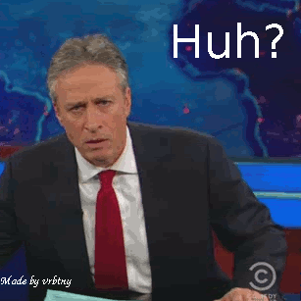

Slide 34
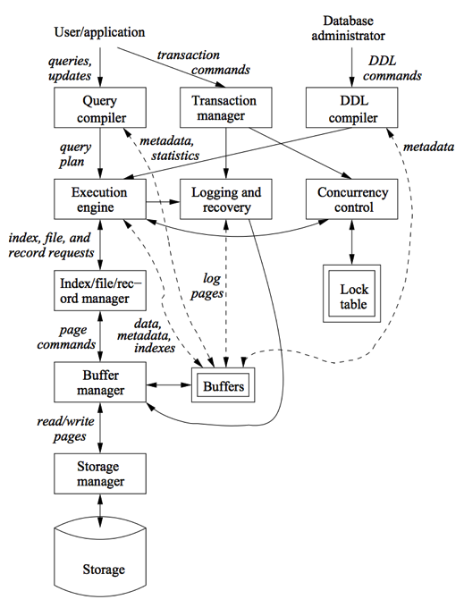

Slide 35
Transaction processing
One or more DB operations can be grouped into a transaction.
For a DBMS to properly implement transactions:
Atomicity: All-or-nothing execution of transactions.
Consistency: A DB can have consistency rules that should not be violated.
Isolation: Each transaction must appear to be executed as if no other transactions are happening simultaneously.
Durability: Any changes a transaction makes must never be lost.

Slide 36
On to the real stuff now…

Slide 37
Data Models
A way of describing data.
Better: a description of how to conceptually structure the data, what operations are possible on the data, and any constraints on the data.
Structure: how we view the data abstractly
Operations: what is possible to do with the data?
Constraints: how can we control what data is legal and what is not?

Slide 38
Relational model
First | Last | Course | Grade
Hermione | Granger | Potions | A
Draco | Malfoy | Potions | B
Harry | Potter | Potions | A
Ronald | Weasley | Potions | C
Structure: relation (table)
Operations: relational algebra (select certain rows, certain columns, where properties are true/false)
Constraints: can enforce restrictions like Grade must be in {A, B, C, D, F}

Slide 39
Other models
Semi-structured data that is still “structured” but not in relational format.
XML, JSON
Object databases, or object-relational
Graph databases
NoSQL, NewSQL

Slide 40
Semi-structured model
Structure: Trees or graphs
e.g., XML
Operations: Follow paths in the implied tree from one element to another.
e.g., XQuery
Constraints: can constrain data types, possible values, etc.
e.g., DTDs (document type definition), XML Schema

Slide 41
Object-relational
Similar to relational, but
Values in a table can have their own structure, rather than being simple strings or ints.
Relations can have associated methods.

Slide 42
Relational model is most common
Simple: built around a single concept for modeling data: the relation or table.
A relational database is a collection of relations.
Each relation is a table with rows and columns.
An RDBMS can manage many databases at once.
Supports high-level programming language (SQL)
Limited but useful set of operations.
Has elegant mathematical theory behind it.

Slide 43
Relation Terminology
Relation == 2D table
Attribute == column name
Tuple == row (not the header row)
Database == collection of relations
First | Last | Course | Grade
Hermione | Granger | Potions | A
Draco | Malfoy | Potions | B
Harry | Potter | Potions | A
Ronald | Weasley | Potions | C

Slide 44
Relation Terminology
A relation includes two parts:
The relation schema defines the column headings of the table (attributes/fields)
The relation instance defines the data rows (tuples, rows, or records) of the table.
First | Last | Course | Grade
Hermione | Granger | Potions | A
Draco | Malfoy | Potions | B
Harry | Potter | Potions | A
Ronald | Weasley | Potions | C
Notes:
Schema is kind of like defining a struct in C++. You define what members the class has and what their data types are.
Each row in a DB is an instance of the class, so an instance of the entire relation is a collection of these rows.

Slide 45
Schema
A schema is written by the name of the relation followed by a parenthesized list of attributes.
Grades(First, Last, Course, Grade)
A relational database schema is the set of schemas for all the relations in a DB.
First | Last | Course | Grade
Hermione | Granger | Potions | A
Draco | Malfoy | Potions | B
Harry | Potter | Potions | A
Ronald | Weasley | Potions | C

Slide 46
Domains
A relational DB requires that every component of a row (tuple) have a specific elementary data type, or domain.
string, int, float, date, time (no complicated objects!)
Grades(First:string, Last:string, Course:string, Grade:char)

Slide 47
Equivalent representations of a relation
First | Last | Course | Grade
Hermione | Granger | Potions | A
Draco | Malfoy | Potions | B
Harry | Potter | Potions | A
Ronald | Weasley | Potions | C
Grades(First, Last, Course, Grade)
Relation is a set of tuples, not a list.
Attributes in a schema are a set as well.
However, the schema specifies a "standard" order for the attributes.
How many equivalent representations are there for a relation with m attributes and n tuples?

Slide 48
Degree and cardinality
First | Last | Course | Grade
Hermione | Granger | Potions | A
Draco | Malfoy | Potions | B
Harry | Potter | Potions | A
Ronald | Weasley | Potions | C
Degree/arity of a relation is the number of attributes in a relation.
Cardinality is the number of tuples in a relation.

Slide 49

Keys to a good relation(ship)

Slide 50
Keys of a relation
Keys are a kind of integrity constraint.
A set of attributes K forms a key for a relation R if:
we forbid two tuples in an instance of R to have the same values for all attributes of K.
First | Last | Course | Grade
Hermione | Granger | Potions | A
Draco | Malfoy | Potions | B
Harry | Potter | Potions | A
Ronald | Weasley | Potions | C
Grades(First, Last, Course, Grade)
Notes:
SEE NOTES

Slide 51
Keys of a relation
Keys help associate tuples in different relations.
SID | First | Last
123 | Hermione | Granger
111 | Draco | Malfoy
234 | Harry | Potter
345 | Ronald | Weasley
SID | CRN | Grade
123 | 777 | A
111 | 777 | B
234 | 777 | A
345 | 777 | C
CRN | Name | Semester | Year
777 | Potions | Fall | 1997
888 | Potions | Spring | 1997
999 | Transfiguration | Fall | 1996
789 | Transfiguration | Spring | 1996
Notes:
Often, many real world databases create artificial keys, because often we want to be 100% sure we will never have any duplicates in combinations of attributes.
What are the keys in these relations? Key for student table = SID. Key(class) = CRN or maybe <CRN,Sem,Year> Key(grades)=all attribs.

Slide 52
Example
Let's expand these relations to handle the kinds of things you'd like to see in BannerWeb.
Keep track of students, professors, courses, who teaches what, enrollments, pre-requisites, grades, departments & their chairs.
Only one chair per department.
Student cannot enroll in multiple copies of the same course in one semester.
Other constraints that are logical.

